Slide 1
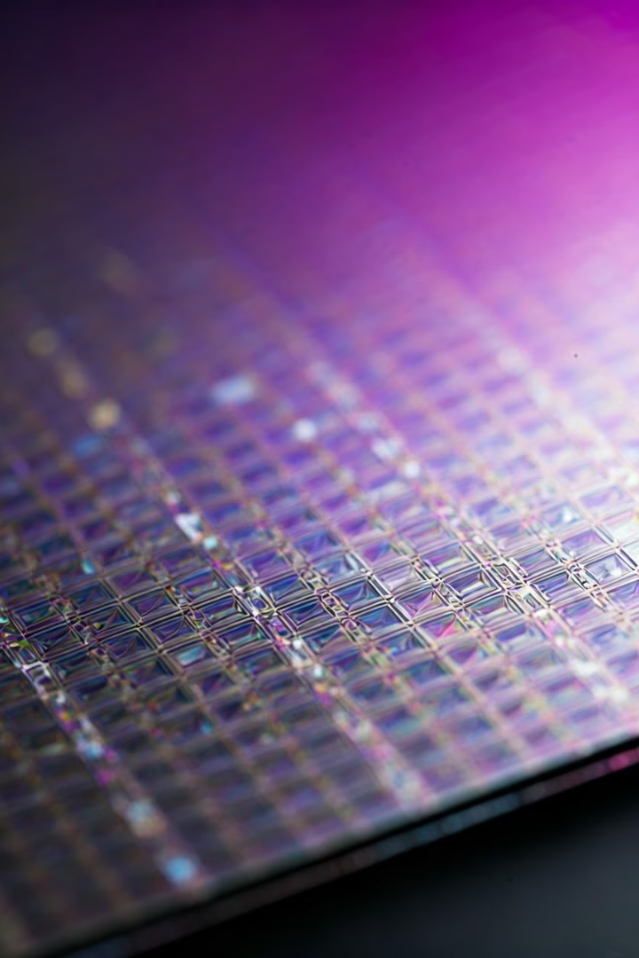
GaN as Neutron Detector
Gallium Nitride (GaN) has emerged as a promising material for neutron detection due to its wide bandgap, radiation hardness, and thermal stability. These properties make it suitable for use in high-radiation environments such as nuclear reactors, space missions, and national security applications. The global shortage of Helium-3 (3He) has driven the search for alternative neutron detection materials, with GaN standing out due to its superior mechanical robustness and ability to operate at lower voltages compared to traditional gas detectors.
by Jatin Kumar

Slide 2

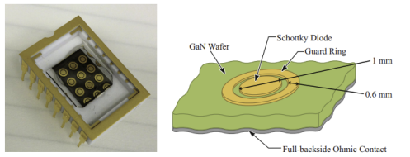
Working Principle
1
Neutron Absorption
GaN-based neutron detectors operate by exploiting the interaction between neutrons and nitrogen-14 (14N) in the GaN crystal lattice. When a thermal neutron is absorbed by 14N, it undergoes a (n, p) reaction, converting to carbon-14 (14C) and emitting a proton.
2
Charge Carrier Generation
The emitted proton generates charge carriers within the GaN material, leading to scintillation, which is then detected by a photodetector such as a photomultiplier tube (PMT) or an avalanche photodiode (APD).
3
Detection Efficiency
The detection efficiency (η) of the neutron detector can be expressed as: η = Ndetected Nincident where Ndetected is the number of neutrons detected and Nincident is the number of neutrons incident on the detector.

Slide 3
Material and Technology Used
MOCVD Growth
HVPE Growth
GaN for neutron detection is typically grown using Metal-Organic Chemical Vapor Deposition (MOCVD) or Hydride Vapor Phase Epitaxy (HVPE). MOCVD-grown GaN films are often doped with Silicon (Si) or Gadolinium to enhance scintillation efficiency and gamma discrimination.
Freestanding GaN wafers, grown via HVPE, are also explored for their potential in high-efficiency charged particle detection. The detectors are fabricated as Schottky diodes, with Ni/Au contacts forming the detection interface.

Slide 4

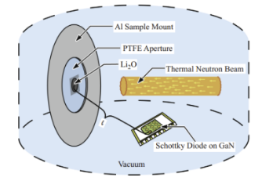



Fabrication Process
GaN Film Growth
The fabrication process begins with the growth of GaN films on sapphire substrates using MOCVD, followed by doping and the addition of neutron conversion layers.
Schottky Diode Patterning
The GaN films are then patterned into Schottky diodes using standard photolithography techniques.
Contact Deposition
Contacts are deposited using electron beam evaporation, and the diodes are mounted on dual inline packages for radiation testing.

Slide 5

Applications
1
Nuclear Reactor Monitoring
GaN-based neutron detectors have significant applications in fields requiring robust, high-temperature, and radiation-resistant detection systems. These include nuclear reactor monitoring, space exploration, and national security for detecting illicit nuclear materials.
2
Space Exploration
The ability of GaN detectors to discriminate between gamma and neutron radiation makes them particularly valuable in mixed radiation fields.

Slide 6

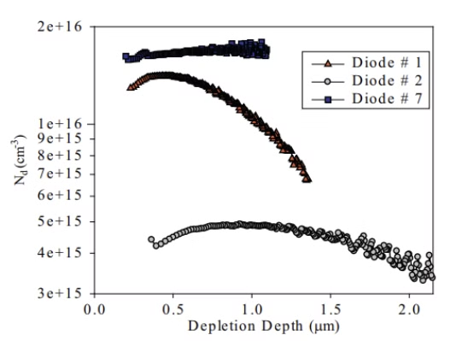
Results and Performance Evaluation
Detector Type
Performance
Si-doped GaN
Excellent gamma discrimination
6LiF-coated GaN
Linear response to reactor power
Freestanding GaN
High charge collection efficiency (CCE) for alpha particles

Slide 7

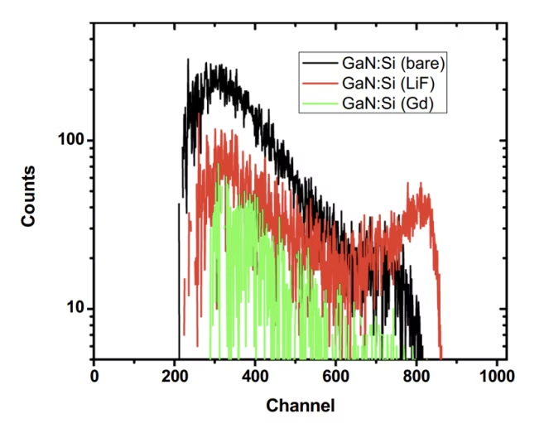
Conclusion
Viable Material
GaN is a viable material for developing high-performance neutron detectors.
Enhanced Performance
Its intrinsic neutron sensitivity, coupled with enhanced performance through doping and conversion layers, positions GaN as a strong candidate for next-generation radiation detectors.
Future Optimization
Further optimization in fabrication and material processing could lead to even more efficient and robust detectors suitable for a wide range of applications.

Slide 8

References
Zhou, C., et al. (2019). Neutron detection performance of gallium nitride-based semiconductors. Scientific Reports, 9(1), 17551.
Mulligan, P., Wang, J., & Cao, L. (2013). Evaluation of freestanding GaN as an alpha and neutron detector. Nuclear Instruments and Methods in Physics Research Section A: Accelerators, Spectrometers, Detectors and Associated Equipment, 708, 7-12.
Zhu, Z., Sun, Z., Zou, J., et al. (2020). Fabrication and performance evaluation of GaN thermal neutron detectors with 6LiF conversion layer. Chinese Physics B, 29 (10), 106102.

Slide 9
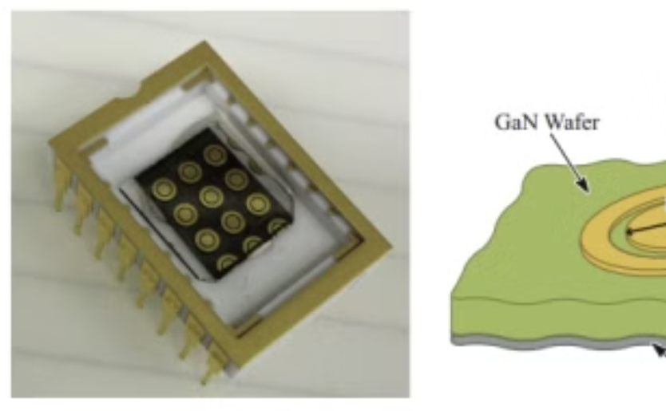
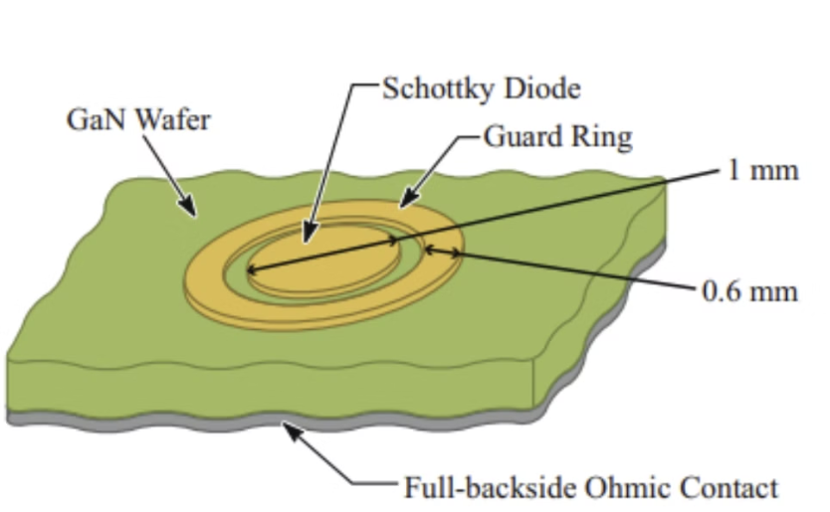
GaN Wafer with Schottky Diodes
GaN Wafer
Schottky Diode
This image shows a GaN wafer with nine Schottky diodes deposited on the Ga-face, including a schematic of a single GaN Schottky diode and guard ring.
This schematic diagram shows a single GaN Schottky diode and guard ring.

Slide 10

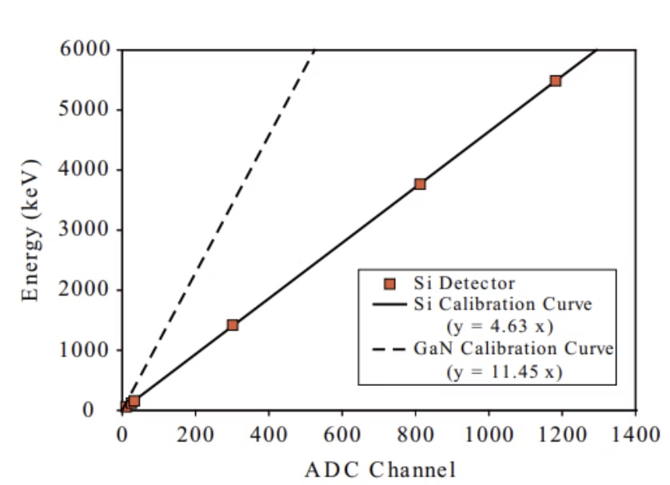


Energy Calibration Curve
Reference Si Detector
Inferred GaN Detector
This graph shows the energy calibration curve of a reference Si detector.
This graph shows the inferred calibration curve for a GaN detector.

